Slide 1
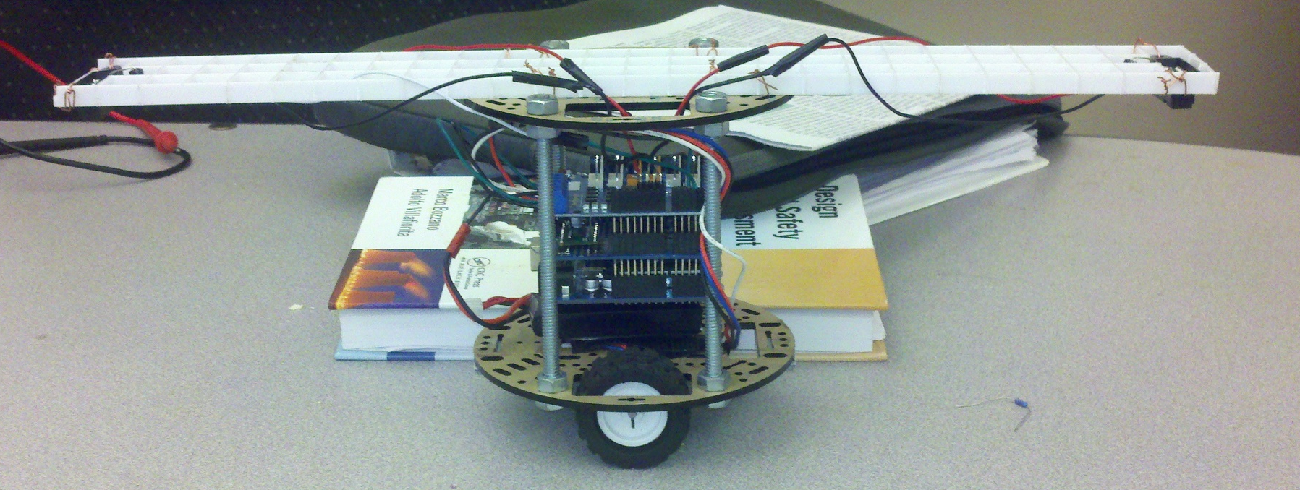
Balance Bot
Robert Finta, Ben O’Brien, Mohammad “Q” Ramli

Slide 2
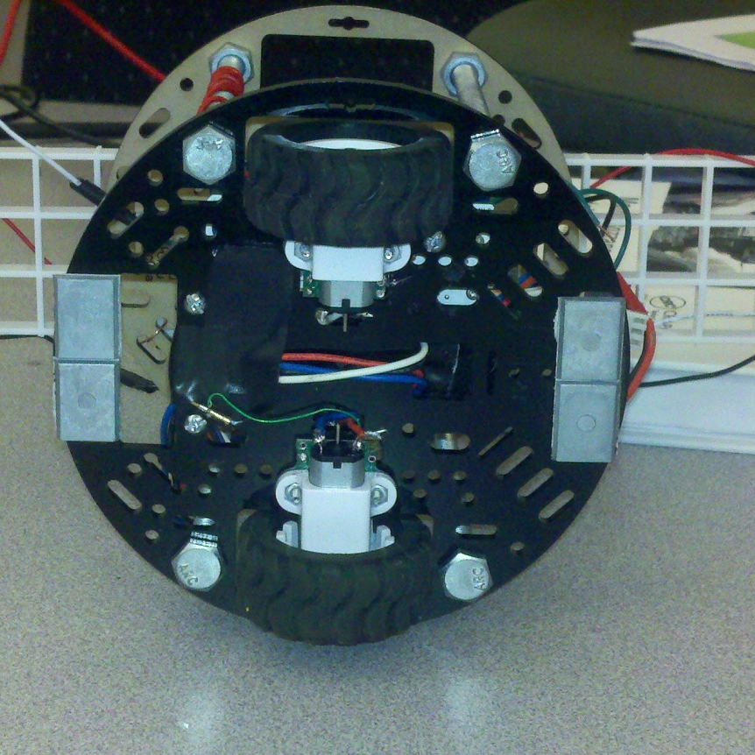
Bill Of Materials
Chassis
Pololu 5” Chassis
Light Weight
Low Cost
Many Mounting options
Motors
Pololu High Power MicroMetal Motors 50:1
High Torque (1.1kg-cm)
High Speed 650RPM
Cheap ($15 a piece)
Mount directly to chassis

Slide 3
Bill Of Materials - 2
Motor Controller
Initially Pololu TB6612FNG Dual Motor Driver
3 A Peak, 1 A continuous per channel
Really Cheap
Changed to Arduino Motor Shield
Simplified wiring
Better response
Much more expensive
Battery
800mAh 2s LiPo 25C

Slide 4
Bill Of Materials - 3
Sensors
Sharp IR Distance Sensors 10-80cm
One for each side of the robot
Used to measure distance to ground and calculate tilt angle
Cheap and easy to use
Parallax L3G4200D Gyro
Much better sensitivity than Sharp Sensors
100Hz update rate, so faster updates

Slide 5
Construction and Assembly
Chassis components connected by 4.5” threaded rod to create two levels
Sensor mounting arm constructed from plastic lighting egg crate. Affixed with twisted wire.
1 ¼” 4-40 for standoffs
Velcro battery attachment
Attached drive train with included hardware

Slide 6

Initial Performance
Simple Bang Bang Control
Controller and power not mounted

Slide 7
Initial Performance Cont.
Everything mounted onboard
On USB tether for data logging
Using a simple P controller

Slide 8
Initial Performance Cont.
Could not sustain balance without tether
Performed data logging with wireless Xbees
Used MATLAB for system identification

Slide 9
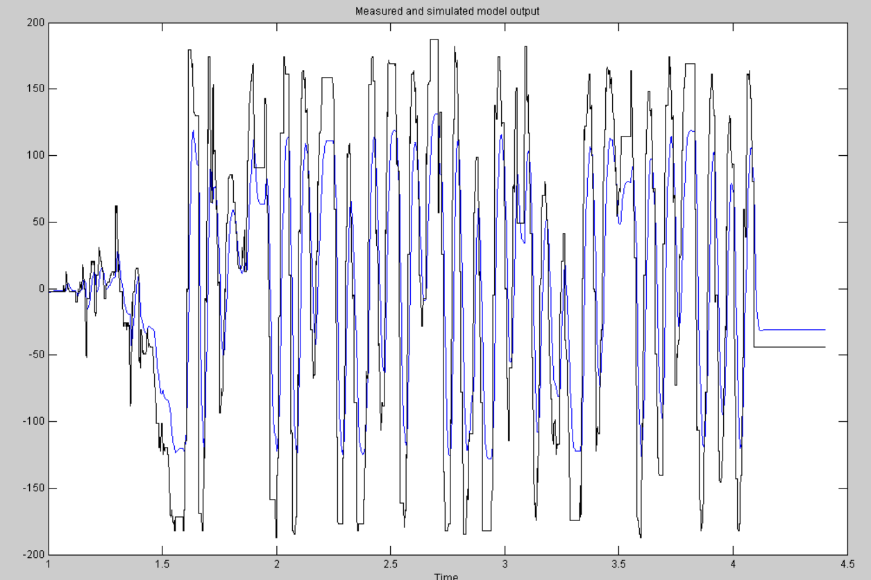
System Identification
Use the least-squared method to determine the best fit transfer function.

Slide 10
Control Simulation
Used SISO tool on generated transfer function
Played around with various controllers:
P, PI, PD, PID
Tuned gain for low overshoot, low rise time, high stability step responses
Generated discrete time transfer functions implemented as difference equations on the Arduino

Slide 11
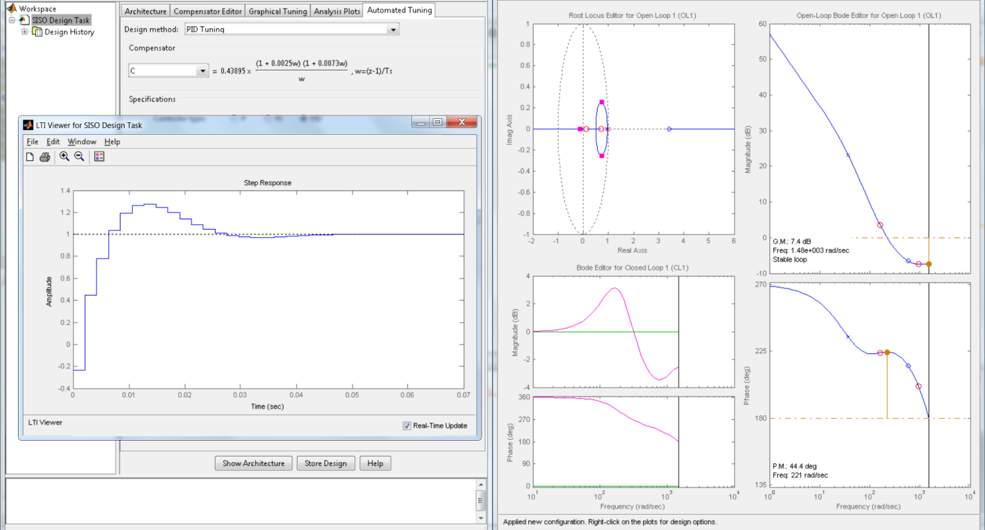
SISO Tool

Slide 12
FIRE
Due to continued oscillations a short led to the destruction of the initial motor controller.
The resulted in a complete gut of control circuitry
Attempted using a free TRex Jr motor controller
What a waste of time
Replaced with an Arduino Motor Shield
System response was actually improved!

Slide 13
Control Revisions
Moved main input from IR Sensors to Gyro
Adapted previous controller and adapted for new Gyro
Tuned gains as necessary
IR Sensors used to correct bias/drift
Achieved better stability but had steady state error

Slide 14
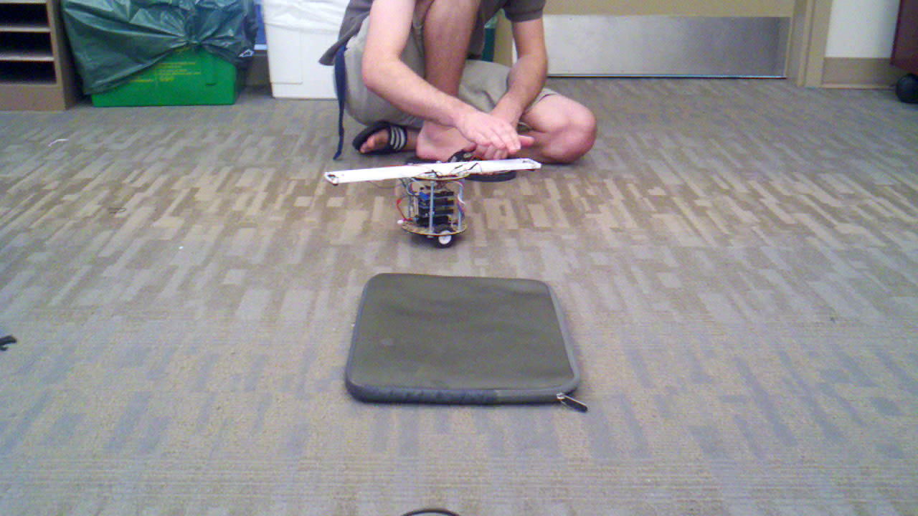
Final Performance

Slide 15
Lessons Learned
Don’t short your motor controller
Get big, smooth, round wheels
Avoid gear boxes
Don’t cheap out on sensors, get the gyro
The tethers are a big factor
Definitely do the analysis as it will get you very close and you just have to adjust the gains slightly

